Slide 1
From Atoms to Action Potentials
Mol Bio Bootcamp
Day 1: 26.8.19

Slide 2
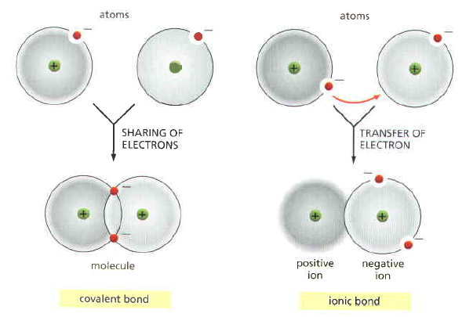
Chemical Bonding
Covalent Bonds

Slide 3
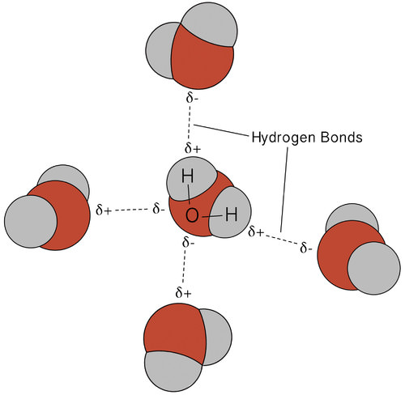
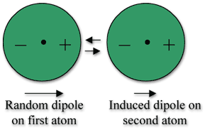
Chemical Bonding
Non-covalent bonds
Hydrophobic interactions
Notes:
H bond- directional, polar atoms, can dismantle ionic bonds
van der waals- weak
hydrophobic- needed in protein folding

Slide 4
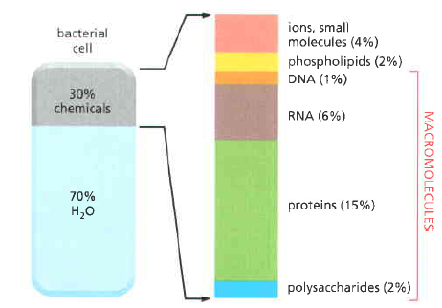

Slide 5
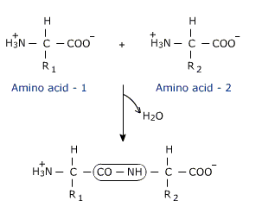
AA to proteins

Slide 6
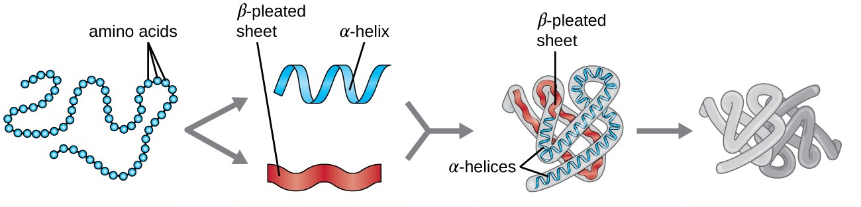
AA to proteins
Notes:
3- side chain and hydrophobic interactions

Slide 7
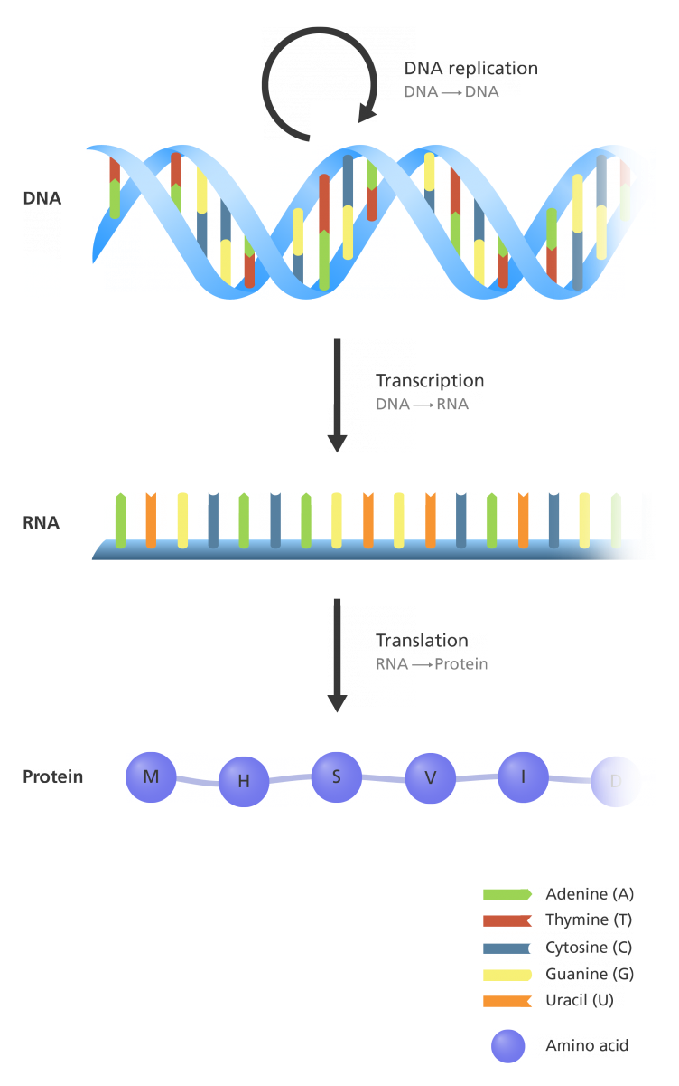
Central dogma
Notes:
genetic code

Slide 8
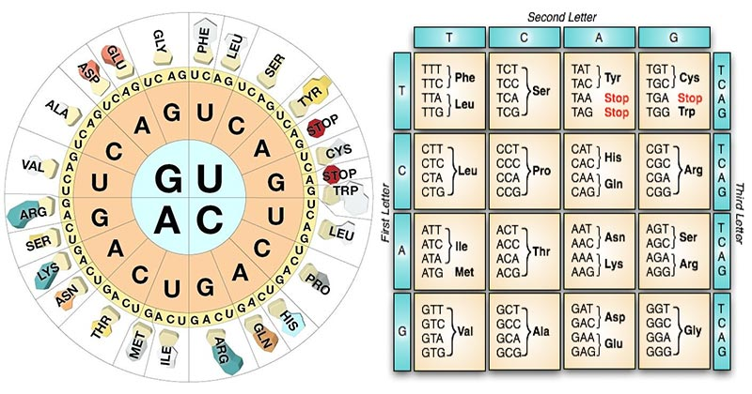
https://learngendev.azurewebsites.net/content/basics/dna

Slide 9
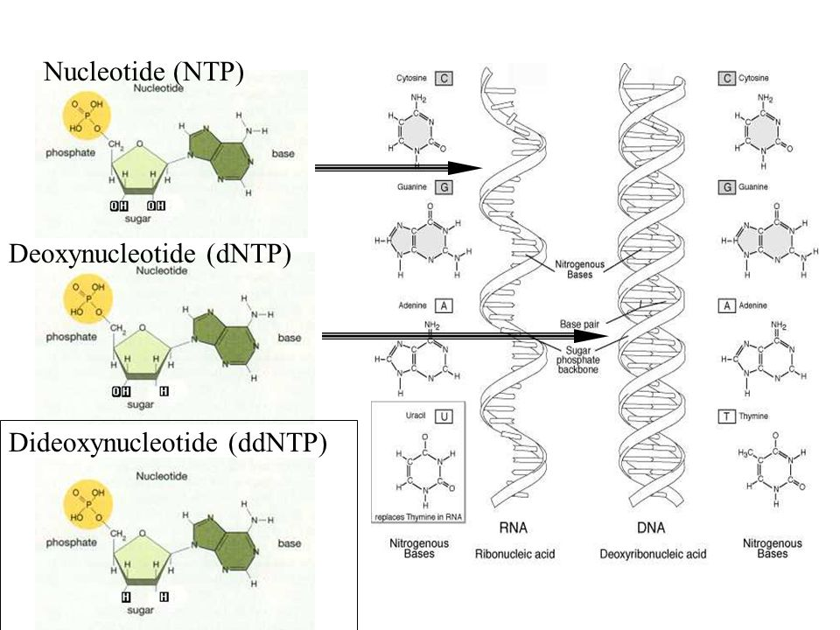

Slide 10
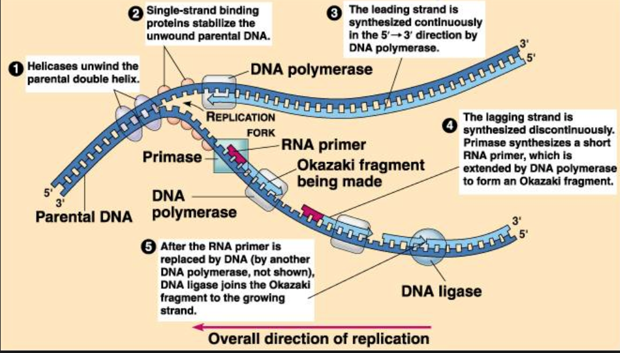
DNA Replication
https://www.youtube.com/watch?v=oCFN5WUoLRI
Notes:
proteins can be promoters, tx factors, regulators, etc.

Slide 11
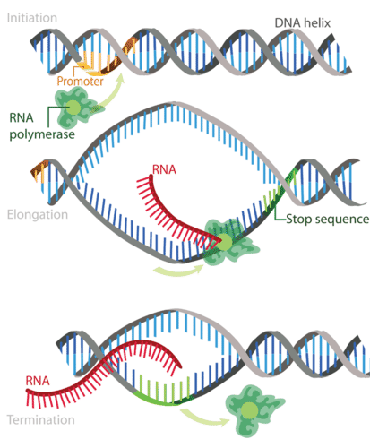
Transcription
https://www.youtube.com/watch?v=-AnsJILjbz8
Notes:
genes have exons and introns. both Txed.
Tx regulation- enhancers, suppressors, methylation (epigenetic markers), DNA packing
Post Tx modif- splicing of introns. mRNA can be spliced differently to encode for diff proteins, distribution and localization

Slide 12
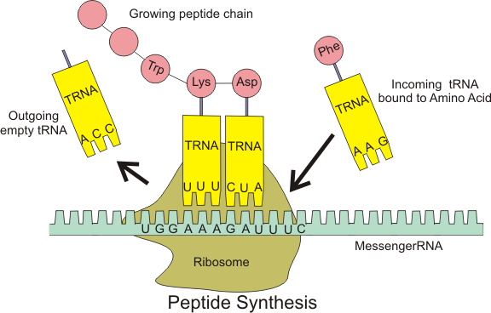
Translation
https://www.youtube.com/watch?v=tTlZQQtoq5Q

Slide 13
Proteins in Neurons
Ion channels
Receptors
Neurotransmitters

Slide 14
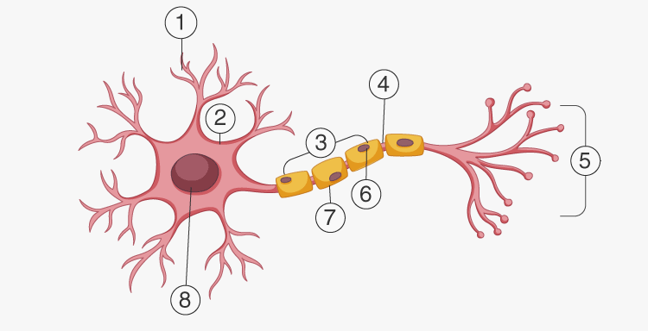
Ion Channels
Notes:
6. Schwann cell
7. Myelin sheath

Slide 15
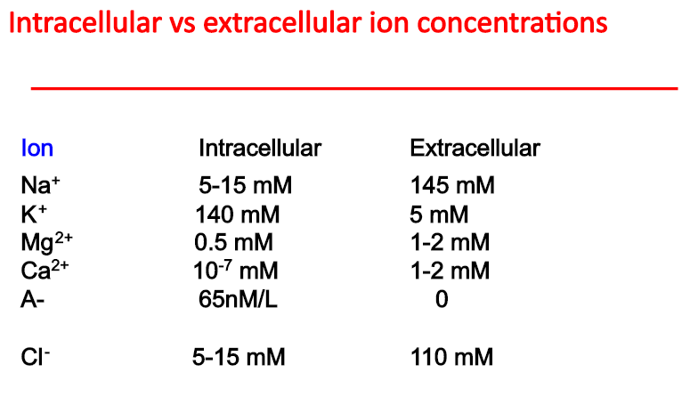
Ion Channels
Notes:
Selective permeability of membrane

Slide 16
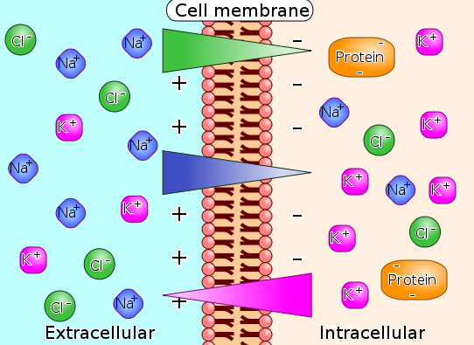
Ion Channels
Notes:
movement goes down electrochemical gradient

Slide 17
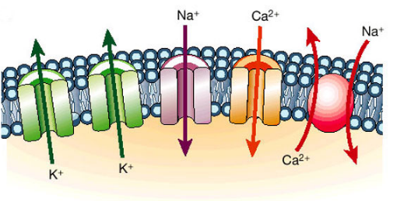
Notes:
active transporters pump against grad. 70% of brain’s ATP

Slide 18
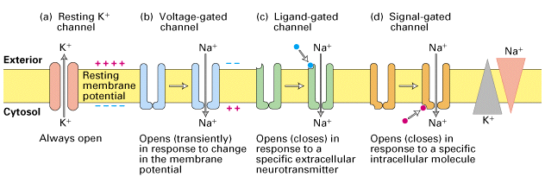
Ion Channels

Slide 19
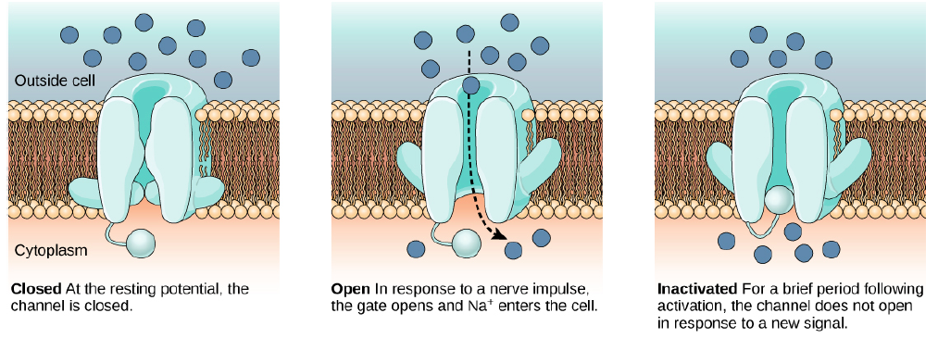
VGNC
Notes:
Ball and chain model of Na gate VGNC

Slide 20
VGKC

Slide 21
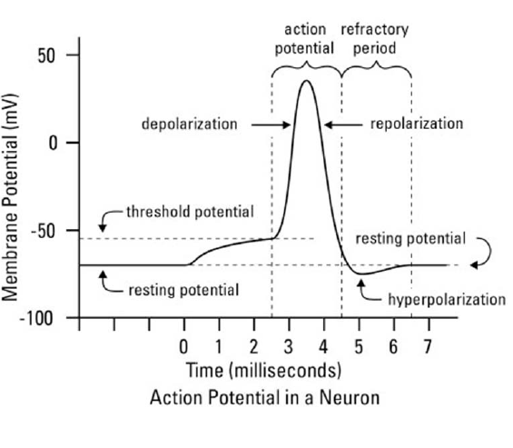
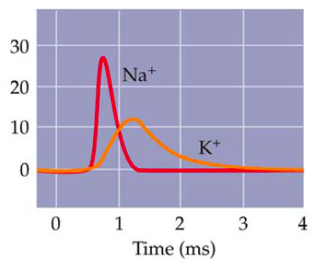
Conductance

Slide 22
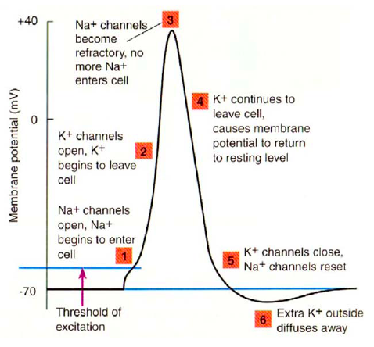

Slide 23
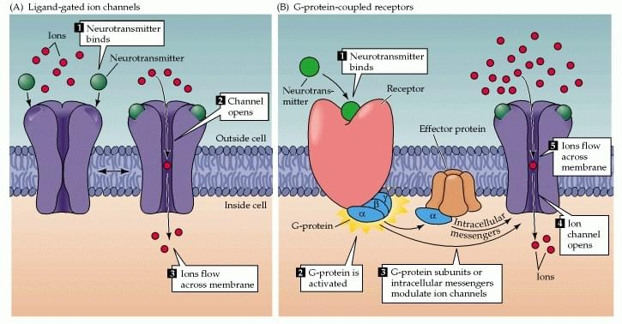
Receptors
Ionotropic

Slide 24
Receptors
Ionotropic
Metabotropic

Slide 25
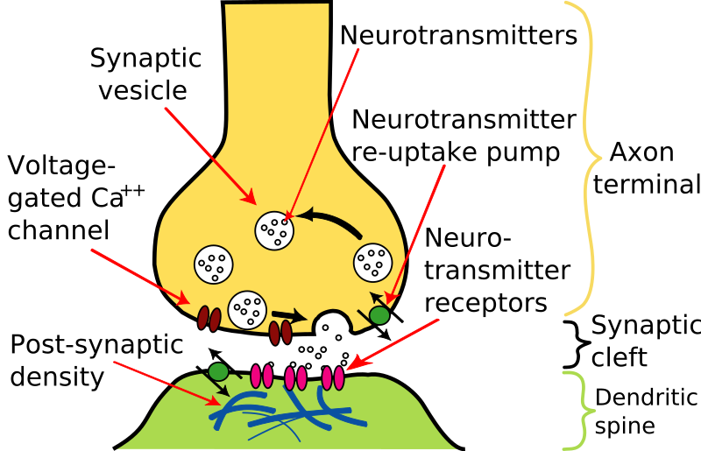
Neurotransmitters
Excitatory, inhibitory
Eg. of NTs: Dopamine, serotonin, GABA, glutamate, etc.

